Slide 1
Speed Measurement Tachometer

Slide 2
Tachometer:
Tachometer is used for measuring rotational speed of the shaft.
Can also be used to measure flow of liquid by attaching a wheel with inclined vanes.

Slide 3
What Are the Different Types of Tachometers?
Tachometers can be classified
1.On the basis of data acquisition
Contact
Non contact types
2. Classified as data type
Analog
Digital
3. On the basis of power .
Mechanical
Electrical
Can also be classified on the basis of different measurement techniques. Time and frequency based, i.e. by registering the number of revolutions in a given period of contact or indicating the number of revolutions per min.

Slide 4
DIFFERENCES
Non Contact Type
The tachometer does not need to be in physical contact with the rotating shaft.
Preferred where the tachometer needs to be mobile.
Generally, laser is used or an optical disk id attached to rotating shaft and read by a IR beam or laser.
Contact Type
The tachometer has to be in physical contact with the rotating shaft.
Preferred where the tachometer is generally fixed to the machine.
Generally, optical encoder / magnetic sensor is attached to shaft of tachometer.

Slide 5
Comparison Between Time and Frequency Based Measurement
Time Based
The tachometer calculates speed by measuring the time interval between pulses
More accurate for low speed measurement
Time to take a reading is dependant on the speed and increases with decrease in speed
The resolution of the tachometer is independent of the speed of the measurement
Frequency based
The tachometer calculates speed by measuring the frequency of pulses
More accurate for high speed measurement
Time to take a reading is independent of speed of rotation
The resolution of the tachometer depends on the speed of the rotating shaft

Slide 6
Comparison Between Analog and Digital Tachometers
Analog Tachometer
Has a needle and dial type of interface
No provision for storage of readings
Cannot compute average, deviation, etc
Digital Tachometer
Has a LCD or LED readout
Memory is provided for storage
Can perform statistical functions like averaging, etc

Slide 7
Comparison Between Contact and Non Contact Tachometers
Contact Type
The tachometer has to be in physical contact with the rotating shaft
Preferred where the tachometer is generally fixed to the machine
Generally, optical encoder / magnetic sensor is attached to shaft of tachometer
Non Contact Type
The tachometer does not need to be in physical contact with the rotating shaft
Preferred where the tachometer needs to be mobile
Generally, laser is used or an optical disk id attached to rotating shaft and read by a IR beam or laser

Slide 8
How To Choose a Tachometer?
Accuracy
Precision
Range
Acquisition Time
Contact type / Non Contact type
Portable / Fixed
Digital / Analog
Cost

Slide 9
Classification of tachometers:
Mechanical Tachometers
Revolution counter
Hand speed indicator
Tachoscope
Centrifugal tachometer
Resonance (vibrating read) tachometer
Electrical Tachometers
Eddy current or drag cup tachometer
Tachogenerator (DC and AC)
Contactless electrical Tachometers
Magnetic pickup tachometer
Photo-electric tachometer
Stroboscope

Slide 10
Mechanical Tachometers

Slide 11
Revolution counter
Revolution counter is used to measure an average of rational speed instead of instantaneous rotational speed.
It consists of a worm gear that is usually attached to a spindle. It has two dials, an inner one and an outer one.
The inner dials represent one revolution of the outer dials and the outer dials represent on revolution of the spindle.
The tachometer has a stopwatch attached to the revolution counter and is used to indicated time.
These are limited to low speed engines and measure satisfactory upto 2000-3000r.p.m.

Slide 12
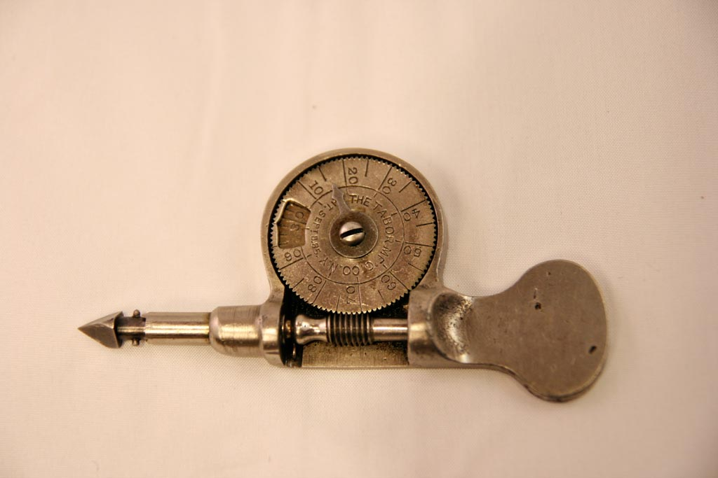
Revolution counter

Slide 13
Hand speed indicator
Hand Speed Indicator has an integral stopwatch and counter with automatic disconnect.
The spindle operates when brought in contact with shaft.
Counter does not function until start and wind button is pressed to start watch and engage the clutch.
The instrument indicates average speed over short interval in r.p.m .

Slide 14
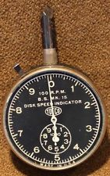
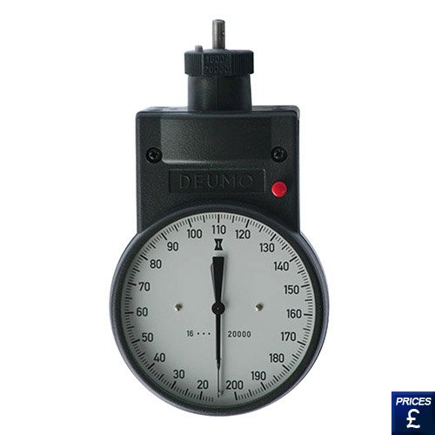
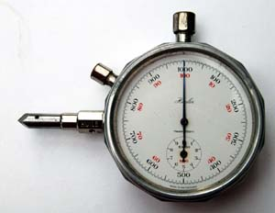
Hand speed indicator

Slide 15
Tachoscope
Tachoscope consists of revolution counter for timing device.
The two components are integrally mounted and start simultaneously when contact point is pressed against rotating shaft.
The rotational speed is computed from reading of counter and timer.
Tachometer can be used to measure speeds up to 5000r.p.m.

Slide 16
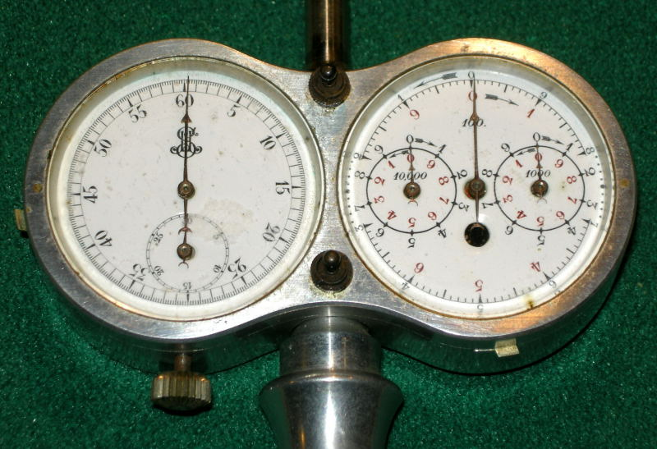
Tachoscope

Slide 17
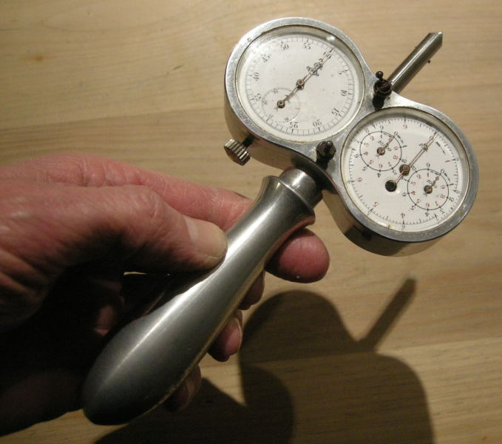
Tachoscope

Slide 18
Centrifugal tachometer
Centrifugal Tachometer operates on principle that centrifugal force is proportional to speed of rotation.
It consists two balls arranged about spindle. Centrifugal force developed by these balls compress spring as function of speed positions pointer.
They are suitable for 4000r.p.m.

Slide 19
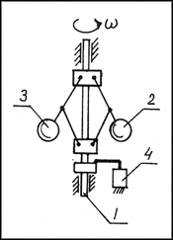
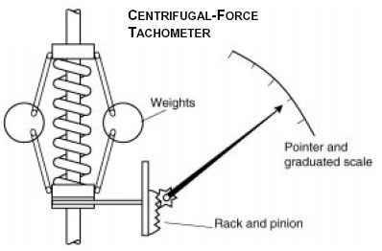
Centrifugal tachometer
w = angular speed, 1 = shaft,
2 and 3 = masses, 4 = displacement-sensitive element.

Slide 20
Resonance (vibrating read) tachometer
In Vibrating Read Tachometers a series of consecutively timed steel rods are used to determine speed on basis of vibrations created by machine.
One end of rod is fixed to a base which is kept in contact with any non-moving part of machine and other is attached to calibrated scale.
These can be used in speed range of 600-10000 rpm .

Slide 21
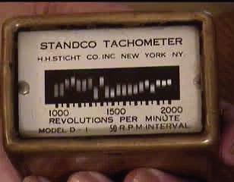
Resonance (vibrating read) tachometer

Slide 22
LIMITATIONS OF MECHANICAL TACHOMETERS
Mechanical tachometers imposes load on rotating shaft which they are connected therefore they absorb the power. Not applicable for shafts involving small power .
More maintenance require.
Faulty parts doesn’t give accurate reading.
It is normally use an arrangement where in a counter is used for counting the numbers of revolution and a stop what is used for measurement of time.

Slide 23
Electrical Tachometers

Slide 24
Eddy current or drag cup tachometer
An eddy-current tachometer uses the interaction of the magnetic fields generated by a permanent magnet and a rotor, whose speed of rotation is proportional to the eddy currents generated.
The currents tend to deflect a disk, which is mounted on the shaft and restrained by a spring, through a certain angle.
The deflection of the disk, which is rigidly connected to a pointer, is indicated on a dial.
Up to 12000 rpm

Slide 25
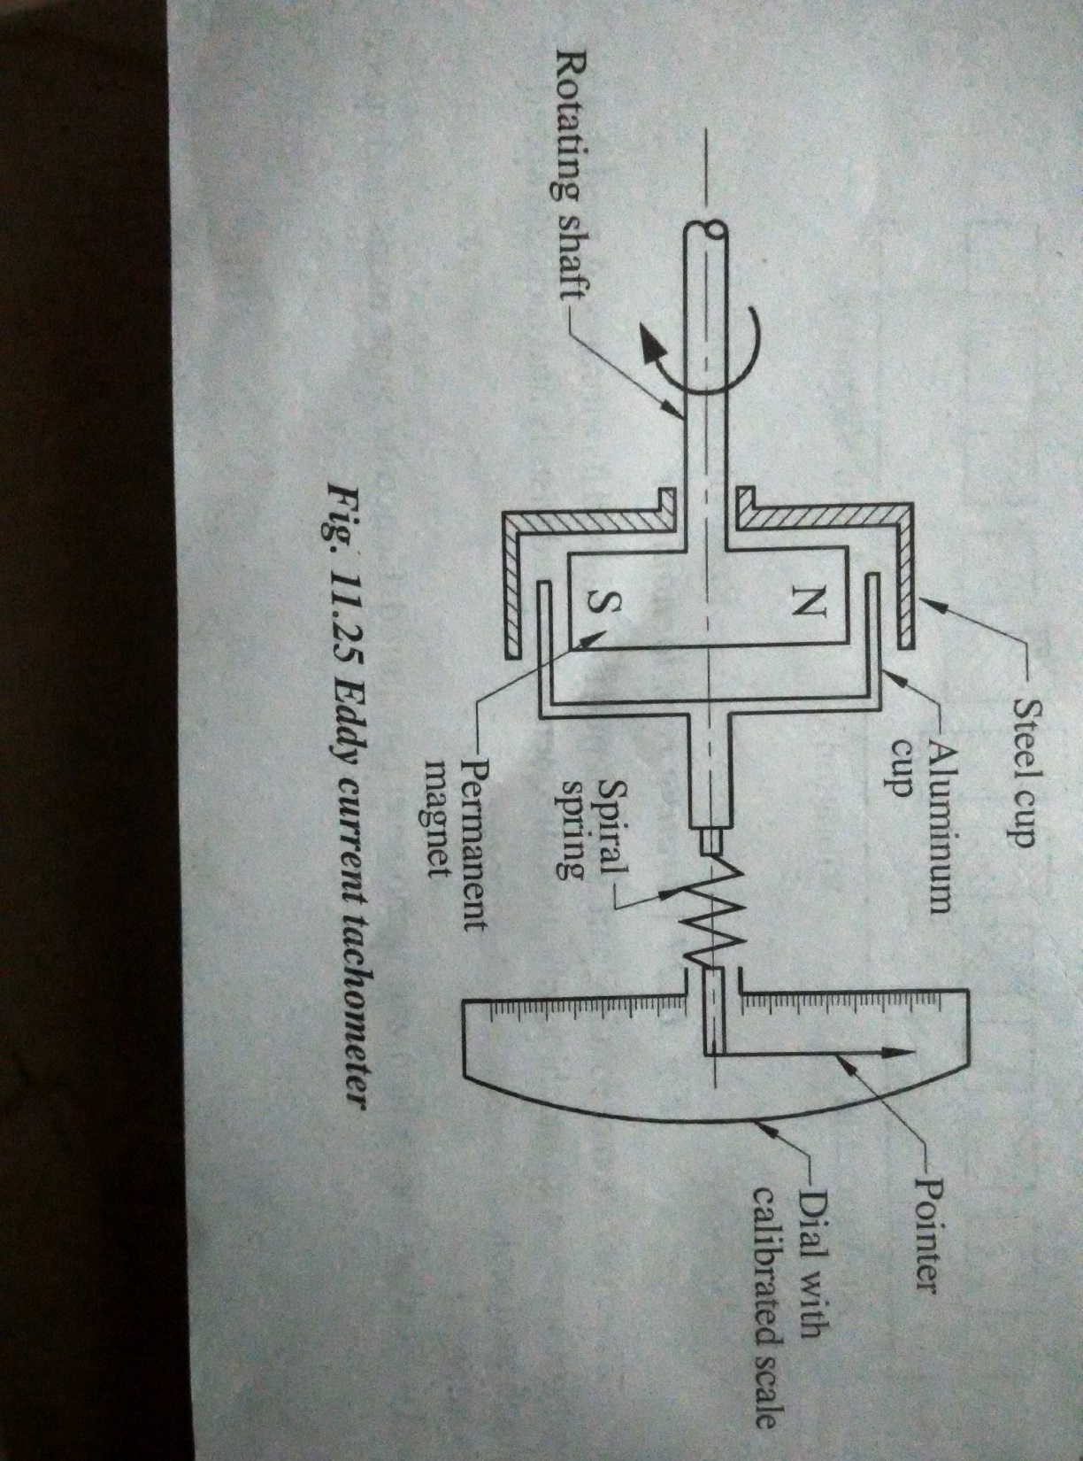
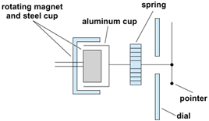

Slide 26
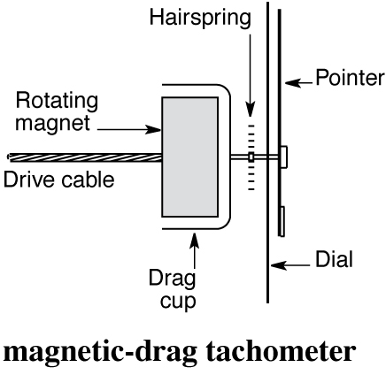
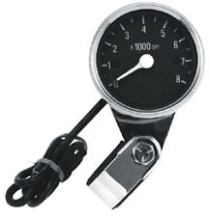
Eddy current or drag cup tachometer

Slide 27
Advantages :
It has a linear relationship between output and rotational speed.
It is rugged and inexpensive.
It requires less maintenance.
It gives ripple free output.
Disadvantages :
These tachometer are hard to calibrate.
At high speed, it has a non-linear relationship between speed and output.
Applications :
(1) Automobile speedometer works base on this principle.
(2) Locomotive speed is measured by this tachometer after some modifications.

Slide 28
D.C. Tachogenerator
In a D.C. generator the e.m.f generated depends upon the following two factors:
(i) Field excitation
(ii) Speed
If for the field system permanent magnet pole pieces are used, then the generated voltage depends only on the speed. Hence the speed can be computed by measuring the generated e.m.f.
The shaft whose speed is to be measured is coupled to the armature.
A moving coil voltmeter is connected across the brushes to measure the generated voltage. The variable resistance R is incorporated to limit the current through the voltmeter.
Since voltage is proportional to speed, the voltmeter may be calibrated in terms of speed (r.p.m.).

Slide 29
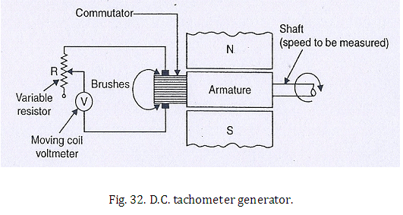
D.C. Tachogenerator

Slide 30
A.C. Tachogenerator
The inherent demerits associated with D.C. tachometer generator, due to the provision of commuter and brushes, are eliminated in A.C. tachometer generator.
It consists of, like an alternator, a stationary armature (stator) and a rotating field system (rotor). Owing to the generation of e.m.f in a stationary coil on a stator, commutation problems no longer exist.
The alternating e.m.f. induced in the stationary coil is rectified, and the output D.C. voltage is measured with the help of a moving coil voltmeter (V).
The ripple content of the rectified voltage is smoothened by the capacitor filter (C).

Slide 31
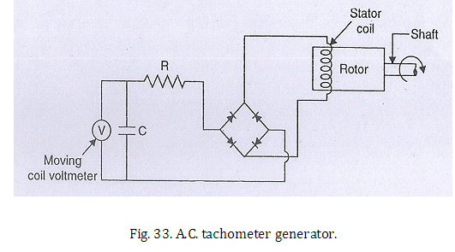
A.C. Tachogenerator
As the speed depends on both the amplitude of the voltage and frequency, anyone of them can be used as a measure of the speed. In an A.C. tachometer, it is the induced voltage that is considered as the required parameter.

Slide 32
Contactless electrical Tachometers

Slide 33
Magnetic pickup tachometer
A coil wounded on permanent magnet not on iron core, this configuration enable us to measure rotational speed of the systems.
In the construction of variable reluctance sensor, we use ferromagnetic gearwheel. As the gearwheel rotates, change in magnetic flux take place in the pickup coil which further induces voltage. This change in magnitude is proportional to the voltage induced in the sensor.

Slide 34
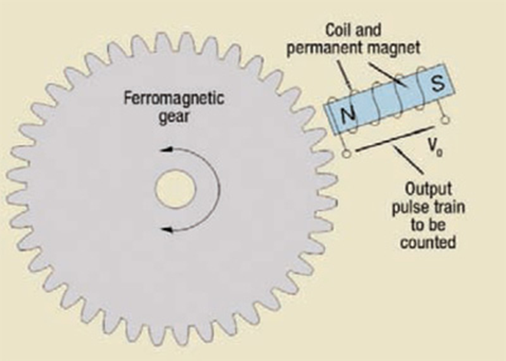
Magnetic pickup tachometer

Slide 35
Pickup tachometer
Various pick-up devices can be used in conjunction with a digital counter to give a direct reading of speed.
An inductive pick-up tachometer is shown in Figure (a).
As the individual teeth pass the coil they induce an e.m.f. pulse which is appropriately modified and then fed to a digital counter.
A capacitive pick-up tachometer is shown in Figure (b). As the rotating vane passes between the plates a capacitance change occurs in the form of a pulse.
This is modified and then fed to the digital counter.

Slide 36
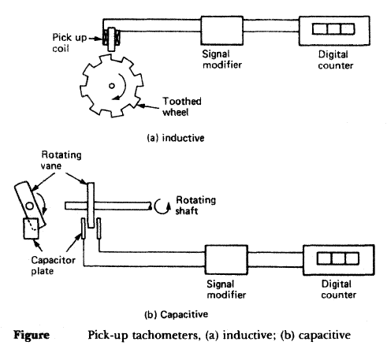
Pickup tachometer

Slide 37
Photo-electric tachometer
It consists of a opaque disc mounted on the shaft whose speed is to be measured. The disc has a number of equivalent holes around the periphery. On one side of the disc there is a source of light (L) while on the other side there is a light sensor (may be a photosensitive device or photo-tube) in line with it (light-source).
On the rotation of the disc, holes and opaque portions of the disc come alternatory in between the light source and the light sensor. When a hole comes in between the two, light passes through the holes and falls on the light sensor, with the result that an output pulse is generated. But when the opaque portion of the disc comes in between, the light from the source is blocked and hence there is no pulse output.
Thus whenever a hole comes in line with the light source and sensor, a pulse is generated. These pulses are counted/measured through an electronic counter.

Slide 38
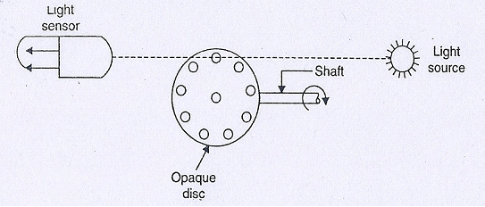
Photo-electric tachometer
The number of pulses generated depends upon the foliowing factors:
i. The number of holes in the disc;
ii. The shaft speed.
Since the number of holes are fixed, therefore, the number of pulses generated depends on thespeed of the shaft only. The electronic counter may therefore be calibrated in terms of speed (r.p.m.)

Slide 39
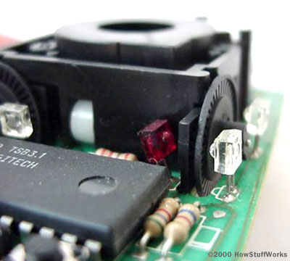
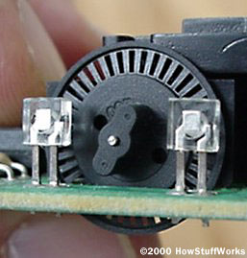
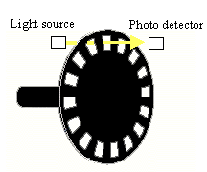
Photo-electric tachometer
Computer mouse with a ball

Slide 40
Stroboscope
The instrument operates on the principle that if a repeating event is only viewed when at one particular point in it’s cycle it appears to be stationary. A mark is made on rotating shaft, and a flashing light is subjected on the shaft. The frequency of the flashing is one very short flash per revolution.
To determine the shaft speed we increases the frequency of flashing gradually from small value until the rotating shaft appears to be stationary, then note the frequency. The frequency then doubled, if there is still one apparent stationary image, the frequency is again doubled. This continued until two images appear 180 degrees apart. When first appear for these two images the flash frequency is twice the speed of rotation.

Slide 41
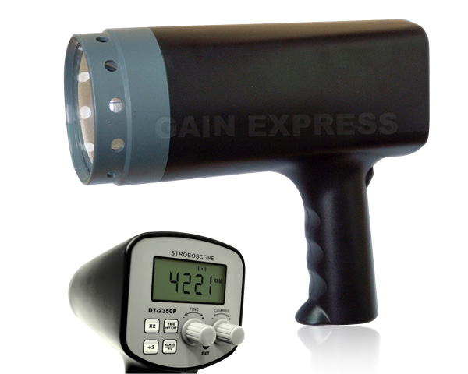
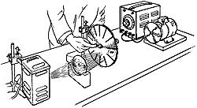
Stroboscope
Stroboscopes are used to measure angular speed between 600 to 20000 rpm .
It’s advantage is that it doesn’t need to make contact with the rotating shaft.

Slide 42
CONCLUSION:
The tachometers have a wide range of applications :
Medicine, the device known as haema-tachometer, is used for estimating the blood flow rate.
Marine fleet, for measuring the rotating speed of the marine diesel machines on the board ships. This device shows the direction towards which the ship rotates.
thank you
ASHISH KATNA
110116011

